Slide 1

CS152 Compiler Design

Slide 2
Instructor and TAs
Rajiv Gupta Professor @CSE
Office hours: Wednesday 11:00am – 12:00n
Friday 10:00am – 11:00n CHUNG 408
Email: gupta@cs.ucr.edu
Teaching: CS201, CS152
Chengshuo Xu TA (Friday Sections)
Office hours: Mon. & Wed: 10:00am -- 11:00am CHUNG 463
Email: cxu009@ucr.edu
Xiaofan Sun TA (Thursday Section)
Office hours: Mon.: 2:00pm – 3:00pm CHUNG 463
Email: xsun042@ucr.edu

Slide 3
Administrivia
Materials: lectures, syllabus and schedule, policies
My website: https://www.cs.ucr.edu/~gupta/teaching/152-20w/
iLearn
Grading
Announcements
For questions
about lectures → Me
about project → TA

Slide 4
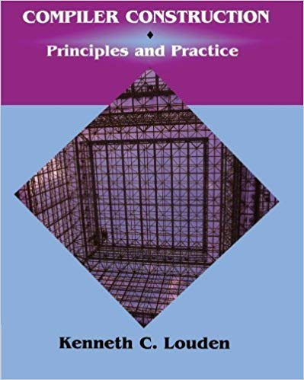
Textbook (primary)
Compiler Construction – Principles and Practice 1997
by Kenneth Louden
1 copy to on reserve in library
TAs have copies also

Slide 5
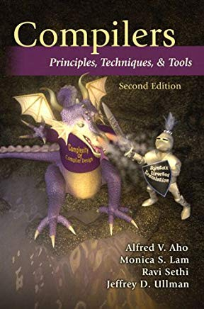
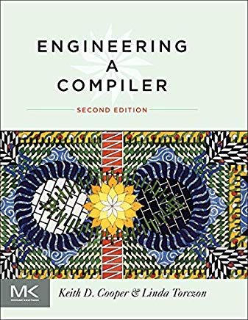
Textbook (references)

Slide 6
Project and Lab
Three phases
one or two weeks each
Date posted on the website
10% + 12% + 13% = 35%
Build a compiler frontend with tools
introduced by TA
Team of two / individual

Slide 7
Grading
Three parts
35% : Project
30% : Exam I 2/7/2020, 12:00n-12:50pm, SPR 1340
35% : Exam II 3/19/2020, 8:00am-11:00am, SPR 1340

Slide 8
Academic integrity
What constitutes academic dishonesty?
Cheating, fabrication, plagiarism, unauthorized collaboration (or facilitating any of these)
What are the penalties and sanctions?
Minimum: receiving an F for the class and adding a record of violation to the student’s life
Maximum: dismissal from the University
Ignorance is no excuse

Slide 9
Chapter 1 What is a Compiler

Slide 10


What is a Compiler?
A program that translates a program written in one language into a program written in another language.
Source
code
Compiler
Assembly/Machine
code
or
Source code
A Interpreter is a program that reads a program and produces the results of executing that program.
Notes:
example:
GCC, Clang/LLVM, Visual C++, icc, XL C
javac, ECJ (eclipse)
CPyhton, PyPy (Rpython)

Slide 11
Language vs. Compiler
C/C++ programs are typically compiled
Script (JS/Python) programs were typically interpreted-only
Java programs are compiled to bytecode (code for JVM)
then interpreted or (just-in-time) compiled

Slide 12
Compilation vs. Interpretation
Advantages (Interpretation)
support dynamic features (dyn. typing & scoping)
portability
Disadvantages (Interpretation)
slower
less reliable

Slide 13
Compilation Phases

Slide 14
Compilation Phases
Lexical Analysis
Phases
A typical compiler is organized into phases
Phases I- IV: Frontend
Phases V-VI: Backend
Error
Handling
Syntax Analysis
Symbol
Table
Semantics Analysis
Interm. Code Gen.
Passes
A traversal of the whole code representation
Code Opt.
Target Code Gen.

Slide 15
Compilation Phases
Lexical Analysis
Example
“Journey” of a statement
Error
Handling
Syntax Analysis
a[i] = 4 + 2
Symbol
Table
Semantics Analysis
Interm. Code Gen.
Code Opt.
Target Code Gen.

Slide 16
Compilation Phases
Lexical Analysis
Lexical Analysis
input: source code (character stream)
output: token stream & errors
Syntax Analysis
Semantics Analysis
a[i] = 4 + 2
Emma likes cats
Interm. Code Gen.
a
[
i
]
=
4
+
2
identifier
left bracket
identifier
right bracket
assignment
number
plus sign
number
“Emma”
“likes”
“cats”
noun
verb
noun
Code Opt.
Target Code Gen.

Slide 17
Compilation Phases
Lexical Analysis
Syntax Analysis
input: token stream
output: parse tree & errors
Syntax Analysis
assign
a
[
i
]
=
4
+
2
identifier
left bracket
identifier
right bracket
assignment
number
plus sign
number
subscript
=
expr
a
[
expr
]
add
i
expr
+
expr
4
2

Slide 18
Compilation Phases
Lexical Analysis
Syntax Analysis
input: token stream
output: abstract syntax tree & errors
Syntax Analysis
assign
a
[
i
]
=
4
+
2
identifier
left bracket
identifier
right bracket
assignment
number
plus sign
number
subscript
add
a
i
4
2

Slide 19
Compilation Phases
Lexical Analysis
Semantics Analysis
input: syntax tree
output: annotated syntax tree & errors
Syntax Analysis
a[i] = 4 + 2
Semantics Analysis
assign
subscript
add
Interm. Code Gen.
integer
integer
a
i
4
2
Code Opt.
array of integer
integer
integer
integer
Target Code Gen.

Slide 20
Compilation Phases
Lexical Analysis
Intermediate Code (IR) Gen.
input: annotated syntax tree
output: IR (three-address code)
Syntax Analysis
a[i] = 4 + 2
Semantics Analysis
assign
subscript
add
Interm. Code Gen.
integer
integer
a
i
4
2
Code Opt.
array of integer
integer
integer
integer
temp. var.
t = 4 + 2
a[i] = t
Target Code Gen.

Slide 21
Compilation Phases
Lexical Analysis
Code Optimizations (many times)
input: IR
output: optimized IR
Syntax Analysis
Semantics Analysis
t = 4 + 2
a[i] = t
assign
Interm. Code Gen.
subscript
6
integer
integer
t = 6
a[i] = t
a
Code Opt.
i
array of integer
integer
a[i] = 6
Target Code Gen.
Notes:
constant folding
copy propagation

Slide 22
Compilation Phases
Lexical Analysis
Target Code Gen.
input: IR
output: assembly/machine code
Syntax Analysis
Semantics Analysis
a[i] = 6
Interm. Code Gen.
mov R0, i ;; value of i → R0
mul R0, 4 ;; multiply R0 by 4
mov R1, &a ;; addr of a → R1
add R1, R0 ;; add R0 to R1
mov *R1, 6 ;; 6 → addr in R1
Code Opt.
Target Code Gen.

Slide 23
Compilation Phases
Lexical Analysis
Target Code Gen.
input: IR
output: assembly/machine code
Syntax Analysis
mov R0, i ;; value of i → R0
mul R0, 4 ;; multiply R0 by 4
mov R1, &a ;; addr of a → R1
add R1, R0 ;; add R0 to R1
mov *R1, 6 ;; 6 → addr in R1
Semantics Analysis
Interm. Code Gen.
Code Opt.
mov R0, i ;; value of i → R0
shl R0, 2 ;; shift left 2 bits
mov &a[R0], 6 ;; 6 → addr in R1
Target Code Gen.
Notes:
two opportunities:
mul --> shift
more powerful addressing mode (specialized instructions designed for array accessing; faster)

Slide 24
Compilation Phases
Lexical Analysis
Example
“Journey” of a statement
Error
Handling
Syntax Analysis
a[i] = 4 + 2
Symbol
Table
Semantics Analysis
Interm. Code Gen.
mov R0, i
shl R0, 2
mov &a[R0], 6
Code Opt.
Target Code Gen.
Notes:
note:
not statement to instruction mapping, statements are considered together (e.g., for declaration, optimization)

